Slide 1

Innovative approaches to overcoming barriers to changing nutrition practices
Daren K. Heyland
Professor of Medicine
Queen’s University
Notes:
Can you insert a watermark of a map of canada behind this text?

Slide 2

Objectives
Describe optimal amounts of protein/calories
required for ICU patients and the barriers to success
Describe several initiatives to improve nutrition delivery including the PEP uP protocol and evidence for effectiveness
Describe a strategy to engage patients’ family members as advocates for best nutrition practice

Slide 3
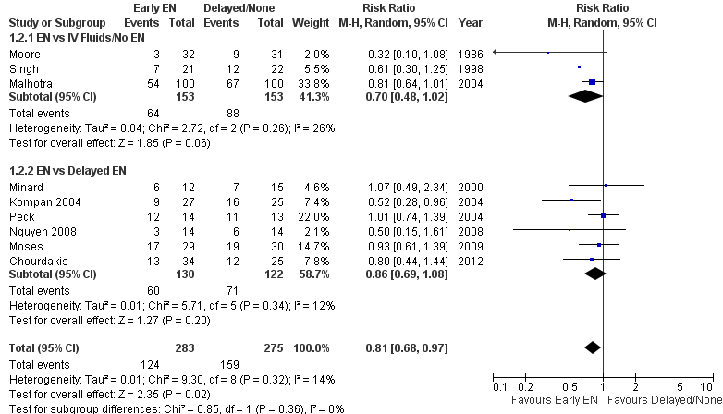
Early vs. Delayed EN:
Effect on Infectious Complications
Updated 2013 www.criticalcarenutrition.com

Slide 4
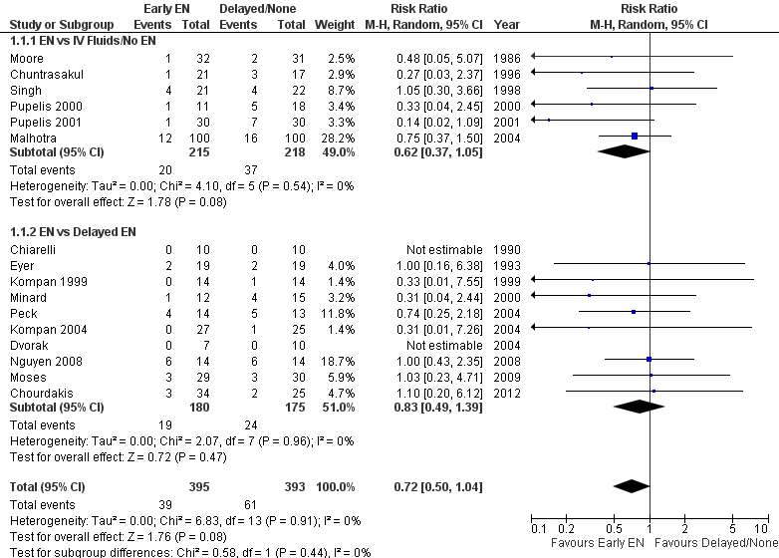
Early vs. Delayed EN: Effect on Mortality
Updated 2013 www.criticalcarenutrition.com
Notes:
R- make sure up to date. DONE

Slide 5
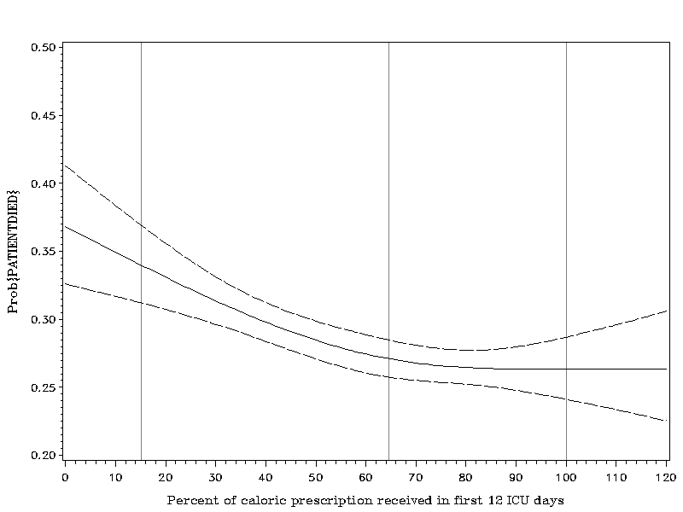
Optimal Amount of Calories for Critically Ill Patients: Depends on how you slice the cake!
Association Between 12-day Caloric Adequacy
and 60-day Hospital Mortality
Optimal amount =
80-85%
Heyland DK, et al. Crit Care Med. 2011;39(12):2619-26.

Slide 6
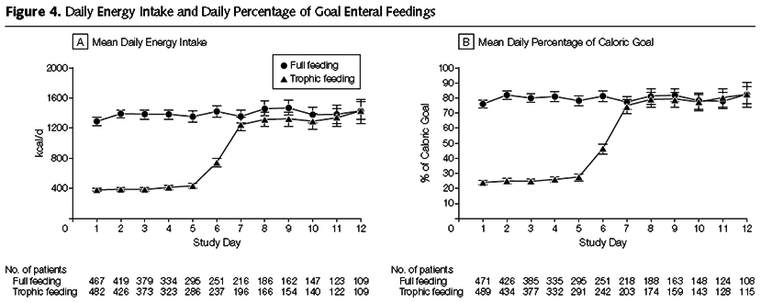
Initial Tropic vs. Full EN in Patients with Acute Lung Injury
The EDEN randomized trial
Rice TW, et al. JAMA. 2012;307(8):795-803.

Slide 7
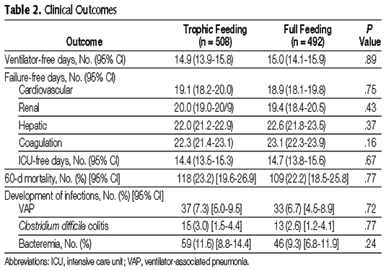
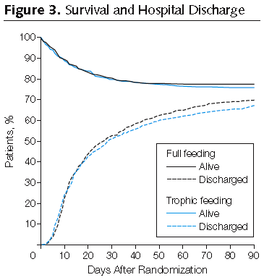
Initial Tropic vs. Full EN in Patients with Acute Lung Injury
The EDEN randomized trial
Rice TW, et al. JAMA. 2012;307(8):795-803.

Slide 8
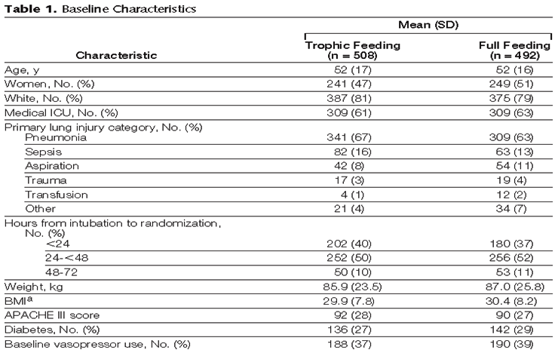
Initial Tropic vs. Full EN in Patients with Acute Lung Injury
The EDEN randomized trial
Enrolled 12% of patients screened
Rice TW, et al. JAMA. 2012;307(8):795-803.

Slide 9
Trophic vs. Full EN in Critically Ill Patients with Acute Respiratory Failure
Average age 52
Few comorbidities
Average BMI* 29-30
All fed within 24 hours (benefits of early EN)
Average duration of study intervention 5 days
No effect in young, healthy,
overweight patients who have short stays!
Heyland DK. Critical care nutrition support research: lessons learned from recent trials.
Curr Opin Clin Nutr Metab Care 2013;16:176-181.

Slide 10
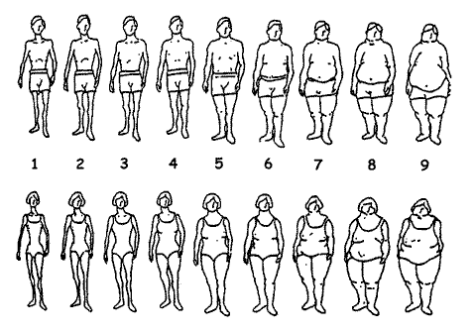
ICU Patients Are Not All Created Equal…
Should we expect the impact of nutrition therapy to be the same across all patients?

Slide 11
A Conceptual Model for
Nutrition Risk Assessment in the Critically Ill
Acute
Reduced po intake
pre ICU hospital stay
Chronic
Recent weight loss
BMI?
Starvation
Nutrition Status
micronutrient levels - immune markers - muscle mass
Acute
IL-6
CRP
PCT
Inflammation
Chronic
Comorbid illness
Heyland DK, et al. Crit Care. 2011;15(6):R268.

Slide 12
The Development of the NUTrition Risk in the Critically ill Score (NUTRIC Score).
Variable | Range | Points
Age | <50 | 0
 | 50-<75 | 1
 | >=75 | 2
APACHE II | <15 | 0
 | 15-<20 | 1
 | 20-28 | 2
 | >=28 | 3
SOFA | <6 | 0
 | 6-<10 | 1
 | >=10 | 2
# Comorbidities | 0-1 | 0
 | 2+ | 1
Days from hospital to ICU admit | 0-<1 | 0
 | 1+ | 1
IL6 | 0-<400 | 0
 | 400+ | 1
AUC | 0.783
BMI, CRP, PCT, weight loss, and oral intake were excluded because they were not significantly associated with mortality or their inclusion did not improve the fit of the final model.

Slide 13
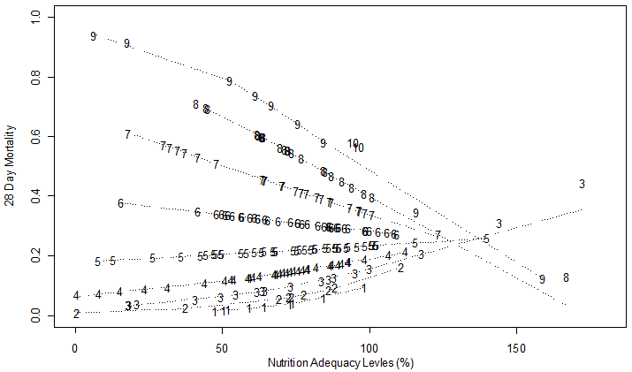
High Nutrition Risk Patients Benefit from More EN Whereas Low Risk Do Not
Interaction Between NUTRIC Score and Nutritional Adequacy (n = 211)*
p-value for the interaction = 0.01
Heyland DK, et al. Crit Care. 2011;15(6):R268.

Slide 14

More (and Earlier) is Better for High Risk Patients!
If you feed them (better!)
They will leave (sooner!)

Slide 15
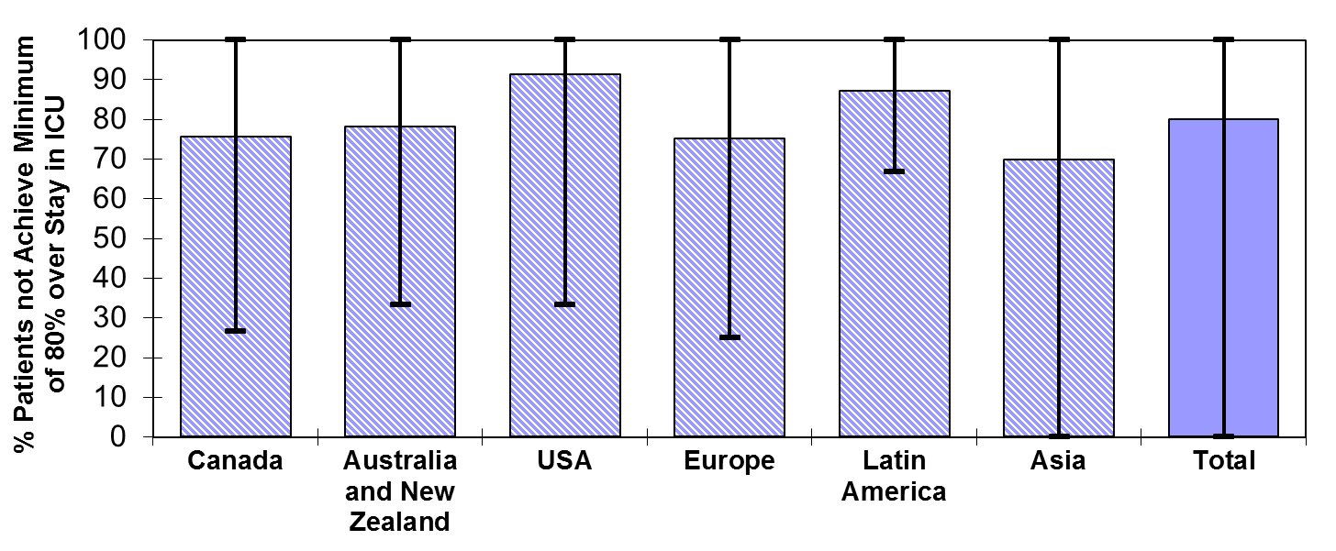
Failure Rate
% high risk patients who failed to meet minimal quality targets (80% overall energy adequacy)
91.2
87.0
75.6
78.1
75.1
79.9
69.8
Heyland 2013 (in submission)

Slide 16
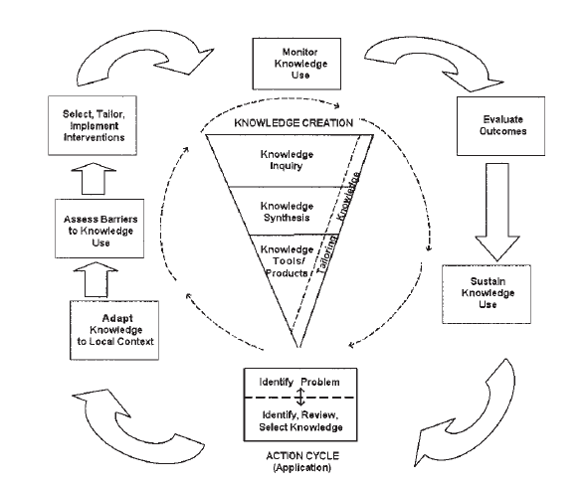
Lost in (Knowledge) Translation!
Knowledge to Action Model by Graham
Heyland JPEN Issue 34, Nov 2010

Slide 17
The Value of ‘Audit and Feedback Reports’ in Improving Nutritional Therapy in the ICU:
A Multicenter Observational Study
26 Canadian ICUs participating in 2007 and 2008 Surveys
(45.1% to 51.9%, p<0.001 and 44.8% to 51.5%, p<0.001 for calories and protein respectively
Sinuff JPEN 2010

Slide 18
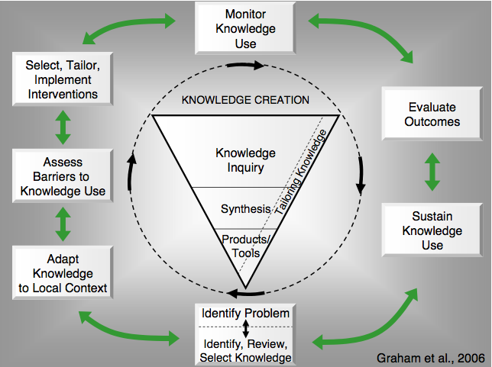
Need to assess Local Barriers
Assess Barriers
&
adapt to local context

Slide 19
Assessing Barriers to
Guideline Adherence
CLINICAL
PRACTICE
GUIDELINE
ADHERENCE
Guideline
Characteristics
Patient Characteristics
Implementation Process
Institutional
Characteristics
Provider Intent
Provider Characteristics
Hospital and ICU Structure
Knowledge
Attitudes
Hospital Processes
Conceptual Framework
Multiple case studies:
4 Canadian ICUs
28 Key informant interviews
Qualitative analysis
Resources
Familiarity
Agreement
Outcome
expectancy
ICU Culture
Awareness
Motivation
Self-efficacy
Jones N et al J Crit Care 2008
Cahill N et al JPEN 2010

Slide 21
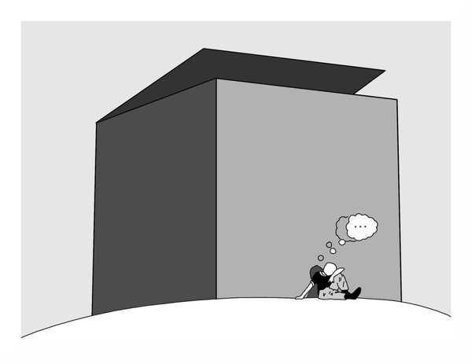
Can we do better with our current feeding protocols?
The same thinking that got you into
this mess won’t get you out of it!

Slide 22

The Efficacy of Enhanced Protein-Energy Provision via the Enteral Route in Critically Ill Patients:
The PEP uP Protocol!
Different feeding options based on hemodynamic stability
and suitability for high volume intragastric feeds.
In select patients, we start the EN immediately at goal rate,
not at 25 ml/hr.
We target a 24 hour volume of EN rather than an hourly
rate and provide the nurse with the latitude to increase
the hourly rate to make up the 24 hour volume.
Start with a semi elemental solution, progress to polymeric.
Tolerate higher GRV* threshold (300 ml or more).
Motility agents and protein supplements are started
immediately, rather than started when there is a problem.
A major paradigm shift in how we feed enterally
* GRV: gastric residual volume
Heyland DK, et al. Crit Care. 2010;14(2):R78.

Slide 23
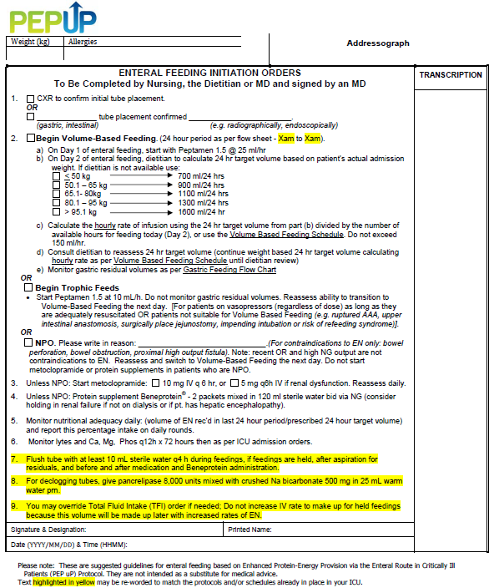

Slide 24
Efficacy of Enhanced Protein-Energy Provision via the Enteral Route in Critically Ill Patients: The PEP uP Protocol
A multi-center cluster randomized trial
Control
18 sites
6-9 months later
Baseline
Follow-up
Intervention
Protocol utilized in all patient mechanically intubated within
the first 6 hours after ICU admission
Focus on those who remained mechanically ventilated > 72 hours
Heyland CCM Aug 2013
Notes:
IT IS OK, I VERBALIZE IT CORRECTLY

Slide 25

Research Questions
Primary: What is the effect of the new innovative feeding
protocol, the Enhanced Protein-Energy Provision via
the Enteral Route Feeding Protocol (PEP uP protocol),
combined with a nursing educational intervention on
EN intake compared to usual care?
Secondary: What is the safety, feasibility and acceptability of
the new PEP uP protocol?
Our hypothesis is that this aggressive feeding protocol combined
with a nurse-directed nutrition educational intervention will be safe, acceptable, and effectively increase protein and energy delivery to critically ill patients.

Slide 26
Tools to Operationalize the PEP uP Protocol
Bedside Written Materials | Description
EN initiation orders | Physician standardized order sheet for starting EN.
Gastric feeding flow chart | Flow diagram illustrating the procedure for management of gastric residual volumes.
Volume-based feeding schedule | Table for determining goal rates of EN based on the 24 hour goal volume.
Daily monitoring checklist | Excel spreadsheet used to monitor the progress of EN.
Materials to Increase Knowledge and Awareness
Study information sheets | Information about the study rationale and guidelines for implementation of the PEP uP protocol. Three versions of the sheets were developed targeted at nurses, physicians, and patients’ family, respectively.
PowerPoint presentations | Information about the study rationale and how to implement the PEP uP protocol. A long (30-40 minute) and short (10-15 minute) version were available.
Self-learning module | Information about the PEP uP protocol and case example to work through independently.
Posters | A variety of posters were available to hang in the ICU during the study.
Frequently Asked Questions (FAQ) document | Document addresses common questions about the PEP uP Protocol.
Electronic reminder messages | Animated reminder messages about key elements of the PEP uP protocol to be displayed on a monitor in the ICU.
Monthly newsletters | Monthly circular with updates about the study.

Slide 27
Analysis
3 overall analyses:
  ITT* involving all patients (n = 1,059)
  Efficacy analysis involving only those that
  remain mechanically ventilated for > 72 hours
  and receive the PEP uP protocol (n = 581)
  Those initiated on volume-based feeds
* ITT: intention to treat
Notes:
YES, PLEASE DO

Slide 28
Change of Nutritional Intake from Baseline to Follow-up of All the Study Sites (All patients)
% Calories Received/Prescribed
p value=0.001
p value=0.71

Slide 29
Change of Nutritional Intake from Baseline to Follow-up of All the Study Sites (All patients)
% Protein Received/Prescribed
p value=0.005
p value=0.81

Slide 30
Daily Proportion of Prescription Received by EN in ITT,
Efficacy and Full Volume Feeds Subgroups
(Among Patients in the Intervention Follow-up Phase)
Notes:
Too late

Slide 31
Compliance with PEP uP Protocol Components (All patients n = 1,059)
Percent
Difference in Intervention baseline vs. follow up and vs. control all <0.05

Slide 32
Complications
(All patients – n = 1,059)
Percent
Vomiting
Regurgitation
Macro Aspiration
Pneumonia
p > 0.05

Slide 33
Nurses’ Ratings of Acceptability
 | After Group Mean (Range)
24 hour volume based target | 8.0 (1-10)
Starting at a high hourly rate | 6.0 (1-10)
Starting motility agents right away | 8.0 (1-10)
Starting protein supplements right away | 9.0 (1-10)
Acceptability of the overall protocol | 8.0 (1-10)
1 = totally unacceptable and 10 = totally acceptable

Slide 34
Usage of PEP uP Training Components
Training Method | % of Respondents Who Received Method | % Somewhat Useful + Very Useful
PP at critical care rounds | 35% | 88.6%
PP by intranet or email | 25% | 55.2%
PP at inservices | 65% | 80.7%
Bedside small group instruction | 24% | 75.6%
Bedside 1-on-1 instruction | 28% | 77.7%
Self learning module | 45% | 76.2%
Bedside letter to staff | 24% | 48.6%
Study posters | 60% | 67.2%
Computer screensaver | 14% | 47.0%

Slide 35
Barriers to Implementation
Difficulties embed into EMR*
Non-comprehensive dissemination
of educational tools
Facilitators to Implementation
Involvement of nurse educator
(nurses owned it)
Ongoing bedside encouragement
and coaching by site dietitian
* EMR: electronic medical records

Slide 36
PEP uP Trial Conclusion
Statistically significant improvements in
nutritional intake
  Suboptimal effect related to suboptimal implementation
Safe
Acceptable
Merits further use
Can successfully be implemented in a broad
range of ICUs in North America

Slide 37
Canadian PEP uP Collaborative
National Quality improvement collaborative in conjunction with Nestle
What we provide
All participating sites will receive:
access to an educational DVD presentation to train your multidisciplinary team
supporting tools such as visual aids and protocol templates
access to a member of the Critical Care Nutrition team who will support each site during the collaborative
access to an online discussion group around questions unique to PEP uP
a detailed site report, showing nutrition performance, following participation in the International Nutrition Survey 2013
online access to a novel nutrition monitoring tool we have developed
Tools, resources, contact information are available at criticalcarenutrition.com

Slide 38
Results of the Canadian PEP uP Collaborative
8 ICUs implemented PEP uP protocol through Fall of 2012-Spring 2013
Compared to 16 ICUs (concurrent control group)
All evaluated their nutrition performance in the context of INS 2013

Slide 39
Results of the Canadian PEP uP Collaborative
 | PEP uP Sites (n=8) | Concurrent Controls (n=16) | P values*
Number of patients | 154 | 290
Proportion of prescribed calories from EN
Mean±SD | 60.1% ± 29.3% | 49.9% ± 28.9% | 0.02
Proportion of prescribed protein from EN
Mean±SD | 61.0% ± 29.7% | 49.7% ± 28.6% | 0.01
Proportion of prescribed calories from total nutrition
Mean±SD | 68.5% ± 32.8% | 56.2% ± 29.4% | 0.04
Proportion of prescribed protein from total nutrition
Mean±SD | 63.1% ± 28.9% | 51.7% ± 28.2% | 0.01

Slide 40
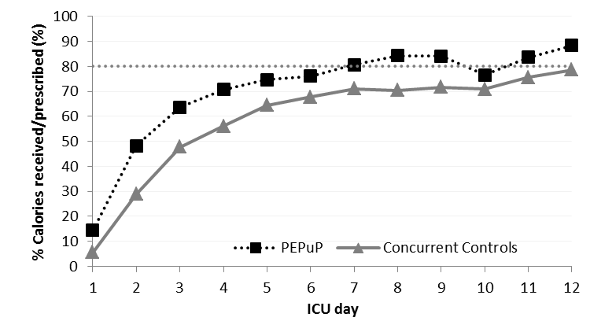
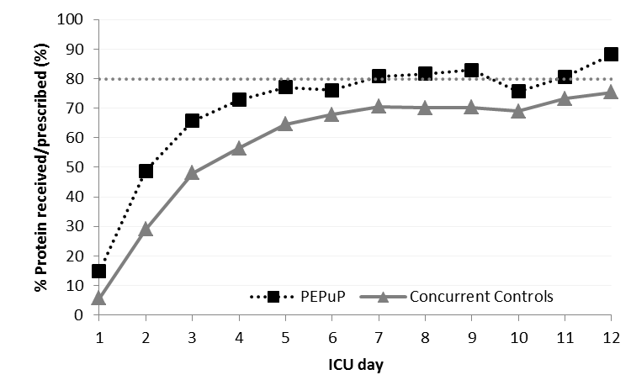
Results of the Canadian PEP uP Collaborative

Slide 41
Results of the Canadian PEP uP Collaborative
Average Caloric Adequacy Across Sites
Average Protein Adequacy Across Sites

Slide 42
Results of the Canadian PEP uP Collaborative
Proportion of Prescribed Energy From EN According to Initial EN Delivery Strategy
Notes:
Need to update with new slide

Slide 43
Results of the Canadian PEP uP Collaborative
Proportion of Prescribed Protein From EN According to Initial EN Delivery Strategy
Notes:
Need to update with new slides

Slide 44
Results of the Canadian PEP uP Collaborative
Patients in PEP uP Sites were much more likely to*:
  receive protein supplements (72% vs. 48%)
  receive 80 % of protein requirements by day 3 (46% vs. 29%)
  receive Peptamen within first 2 days of admission (45% vs. 7%)
  receive a motility agent within first 2 days of admission (55% vs. 10%)
No difference in glycemic control
*All comparisons are statistically significant p<0.05

Slide 45
Major Barriers to Protocol Implementation
Time consuming local approval process
Continuing education efforts for nursing staff
Changing the ICU culture
Concern regarding the use of motility agents
Concern regarding patients at risk of refeeding syndrome

Slide 46
Conclusions
PEP uP protocol can be successfully implemented in real practice setting in Canada with no/limited additional resources provided

Slide 47
Next Steps
Initiate US PEP uP collaborative Spring 2014
Application due Feb 16, 2014
See our website for details
Other countries interested?

Slide 48
Start PEP uP
Day 3
> 80%
of goal calories
Yes
No
Carry on!
High
risk?
Yes
No
Maximize EN with motility agents
and small bowel feeding
No problem
Not
tolerating
EN at
96 hrs?
Yes
No
Supplemental PN?

Slide 49

OPTimal nutrition by Informing and Capacitating family members of best practices:
The OPTICs feasibility study
Investigators
Andrea Marshall, RN, MN, PhD
Daren Heyland, MD, FRCPC, MSc
Naomi Cahill, RD, PhD candidate
Rupinder Dhaliwal, RD

Slide 50
Gap exists: best practice & current practice
Evidence-based nutrition guidelines are inconsistently implemented
Large scale, multi-faceted interventions have failed to improve nutrition practices & have not improved nutritional adequacy for the critically ill
Engaging family members to act as advocates for nutrition may be a promising strategy to narrow the gap between best practice & current practice both in the ICU and post ICU
Notes:
Lack of literature in advocating family centered care

Slide 51
Objectives: Definitive study
Hypothesis
Educating families about the importance of nutrition and having them advocate for better nutrition for their loved one in the ICU will result in better nutrition delivery during critical illness and in the recovery phase
Notes:
Cluster RCT? How many sites?

Slide 52
Evidence for Family advocacy
Literature supports family-centered care^{1,2,3,4}
Families and ICU staff are very supportive of family involvement in patient care. Most patients are also favourable of family involvement in their care¹
Notes:
For best practice

Slide 53

Objectives: Feasibility Study
Primary aim:
Evaluate the feasibility and acceptability of an intervention designed to educate family members about the importance of adequate nutrition in ICU and during recovery from critical illness

Slide 54
Study Design
Mixed method study, n=90 patients & families
45 ICU patients
& families from
3 ICUs
Stage 1, Low intensity intervention
Family Education session
Patient nutrition history completed with family
Family & Heath Care Providers interviewed
Stage 2, Moderate intensity intervention
Family Education session
Patient nutrition history completed with family
Family & Heath Care Providers interviewed
+
Daily nutrition diary completed by family following extubation and resumption of oral intake
Review of methods after completion of stage 1 and before progression to stage 2
45 ICU patients
& families from
3 ICUs

Slide 55

Intervention: Family education session & patient nutrition history
  Occurs within 72 hours of ICU admission by dietitian
Education session and booklet
Information about nutrition therapy
Nutrition therapy risks, side effects
Initiating oral feeds following EN or PN
How family members can be advocates for
the best nutrition practices
Nutrition history (Family member)
Weight loss history
Past diets, food intolerances/allergies, GI problems
Chewing/swallowing difficulties
Eating patterns
Food preferences

Slide 56
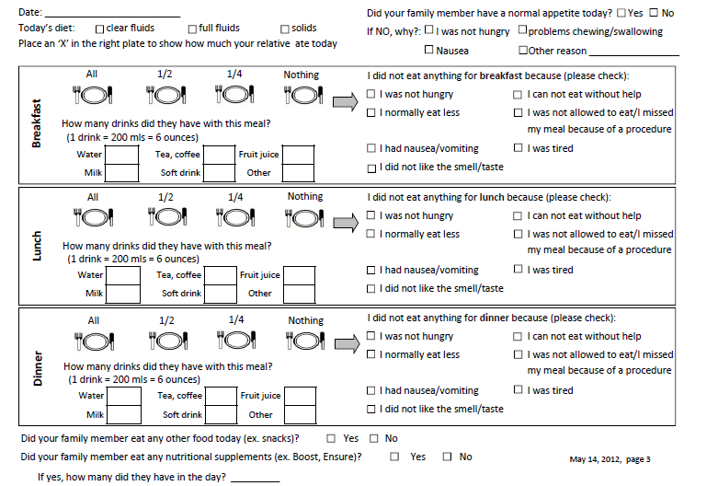
Moderate Intensity: Food Diary

Slide 57
OPTICS
Preliminary Results
Retained 77% of participants
100% would participate again and recommend to others
Easy to understand and comfortable advocating for optimal nutrition n=22 (88%)
Satisfaction with nutrition ≥8/10 for 23 participants (92%) but decreased to 50% on the ward
12/13 patients (92.0%) considered family participation acceptable

Slide 58
In Summary, I Have…
Described optimal amounts of protein/calories
required for ICU patients and barriers to success
Described the rationale for and success with the PEP uP protocol
Described a strategy to effectively engage patient’s family members to advocate for best practice

Slide 59
Thank you for your attention.
Questions?

